Slide 1

Image scraping and classification
By Priyanka

Slide 2
Introduction
What is Image classification?
Ability of a computer to analyse an image and identify the class image falls under. It is supervised learning problem.
Background
Earlier raw pixel data used by computer to classify image. This method was not feasible as two similar pictures could look way different due to many factors.
Deep learning enters
Deep learning made this work easier by passing image through hidden layer of nodes. Image classification become easier with deep learning.

Slide 3
Dataset
Images of saree, men jeans and men trouser from amazon are scraped using selenium for the project.
Images were stored in two different folders of test and train each having three subfolders containing image belonging to each class.
These three subfolders would serve as three categorical classes when uploaded.

Slide 4
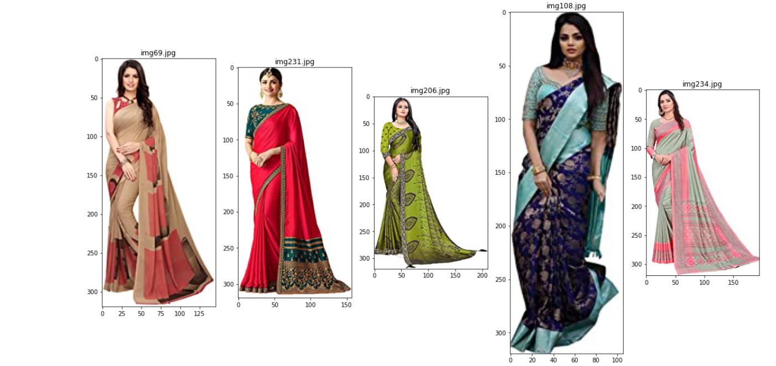
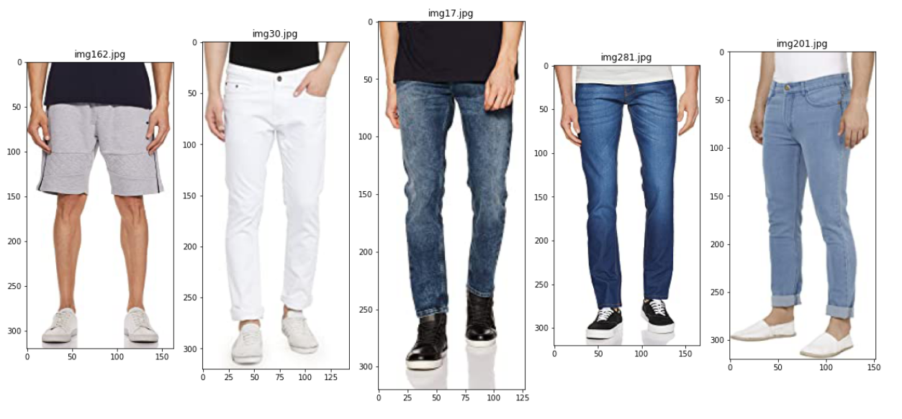
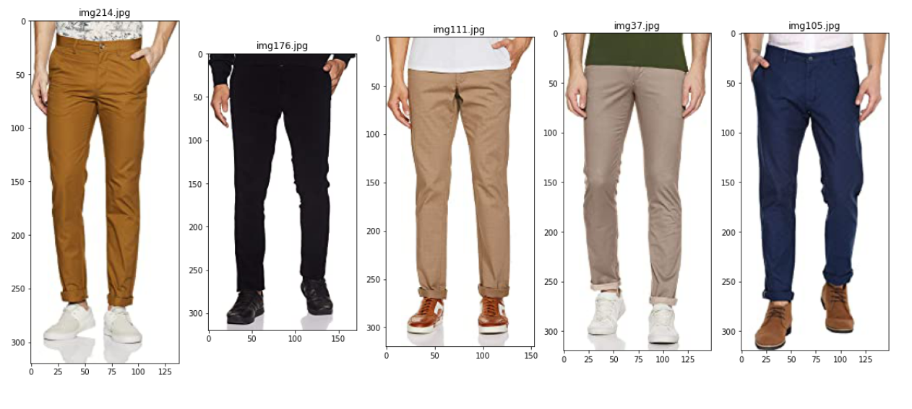
Visualization
Using os module we have extracted the folders and used open cv method to load the random 5 images from the folders. Images appeared as shown below.

Slide 5
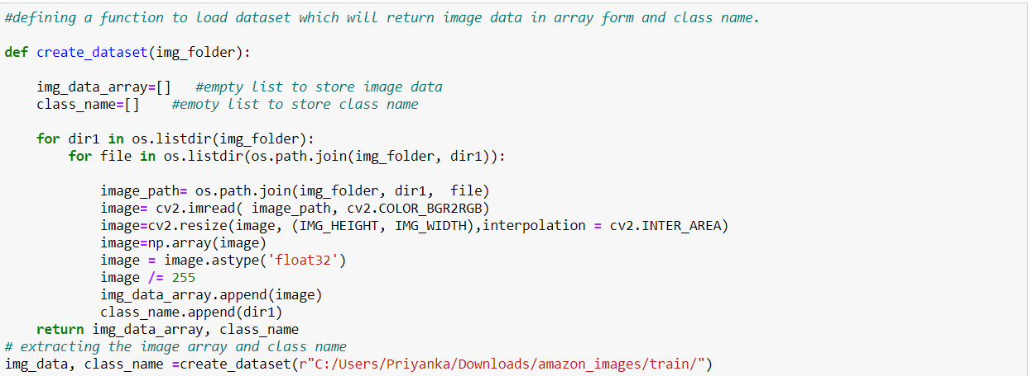
Loading The Dataset
Below function was called to load the train and test dataset in the notebook.
The function returned image in array form and class to which the image belongs.

Slide 6
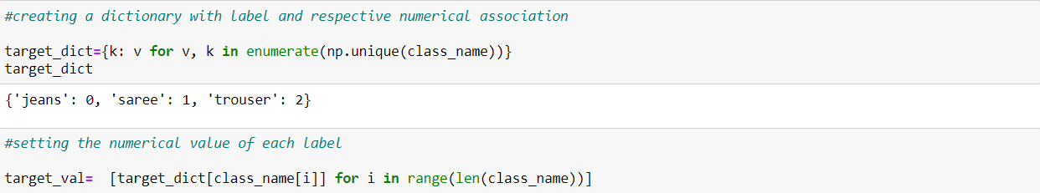
Splitting data into train and test
A dictionary was created to map each class label to integer representation and further these representations were used to build labels as shown below.
Image_array was used as x_train and class labels were y_train.

Slide 7
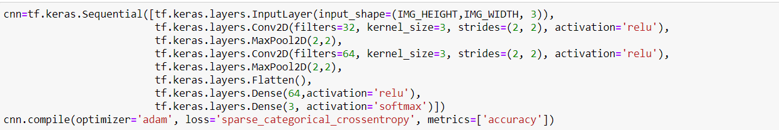
Model Training and Testing
Building a convolutional neural network
The model type that we will be using is Sequential.
We have 2 Conv2D layers first layer with 32 nodes and second with 64 nodes.
The activation function we will be using for convolutional layers is ReLU, or Rectified Linear Activation.
In between the Conv2D layers and the dense layer, there is a ‘Flatten’ layer. Flatten serves as a connection between the convolution and dense layers.
We will have 3 nodes in our output layer, one for each possible outcome (0-2).
The activation is ‘softmax’.

Slide 8
…contd
Next, we need to compile our model. Compiling the model takes three parameters: optimizer, loss and metrics.
The optimizer controls the learning rate. We have used ‘adam’ as our optimizer.
We will use ‘sparse_categorical_crossentropy’ for our loss function. This is the most common choice for integer type classification.
‘accuracy’ metric is used to see the accuracy score of the model.
Model training - using the fit() method we fit the training data using 25 epochs.
After 19 epochs accuracy score of 1 was achieved.

Slide 9
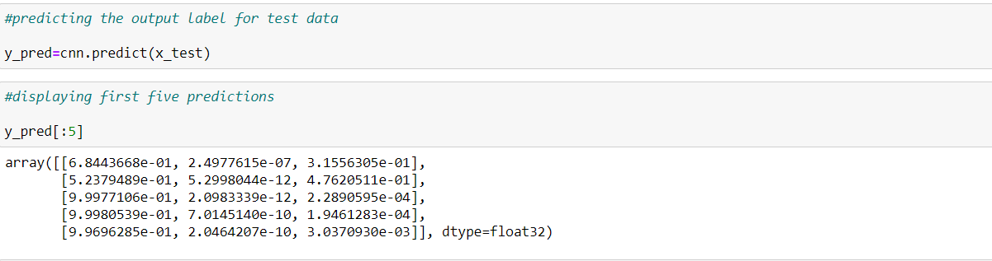
Predicting with CNN
Using predict method to predict the classes.
Results are in array, index of the highest number is the model prediction.
Index of the highest numbers are 0, 0, 0, 0, 0 which are also the actual labels.

Slide 10
Performance Metrics
Our model was able to classify the images into the categories fairly well as we got the accuracy score and f1 score of 0.94 each.
Error Metrics | Result
Accuracy Score | 0.9366
F1 Score | 0.9367

Slide 11
Conclusion
Successfully built an end-to-end deep learning model which could classify Saree, Trouser and Jeans with good accuracy.

Slide 12
Thank You

